Slide 1

Syllogism
Deductive Reasoning

Slide 2

Definition
A logical argument to arrive at a conclusion based on two or more statements that are assumed to be true.

Slide 3
Objective
For a given two or more statements followed by conclusions, to decide which of the conclusion follows.
Note: You must consider the statements to be true even if it seems to be at variance from commonly known facts.

Slide 4
Types of Statements
All: U +ve
All cats are rats
Some: P +ve
Some cats are rats
Some not: P -ve Some cats are not rat
No: U -ve
No cat is a rat

Slide 5
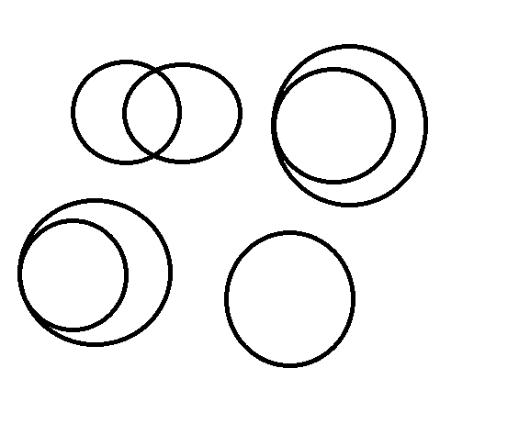
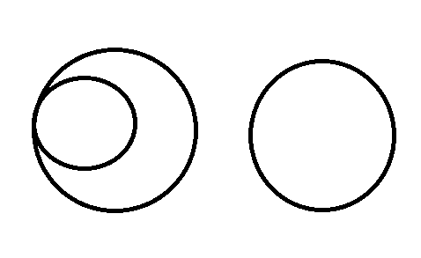
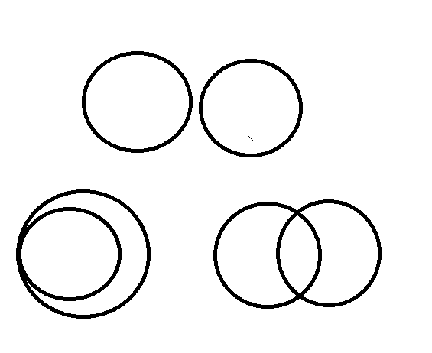
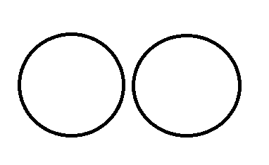
Possibilities

Slide 6
Negation
All ⬄ Some not
No ⬄ Some
Note: For a conclusion and its negation, both cannot be true at a time and both cannot be false at a time.

Slide 7
Logic
To validate a given conclusion, prove the negation of the conclusion true by drawing one such diagram without violating any of the given statements. If you succeed in showing one such case, means the negation is true i.e., given conclusion is false/does not follow otherwise true/follows.

Slide 8
Problem 1
Statements: Some pens are glass. All glass are wall.
Conclusions: I. Some wall are pens.
II. Some wall are glass.
Only conclusion I follows
Only conclusion II follows
Both conclusion I & II follow
Neither conclusion l nor conclusion II follows
Ans: Option c

Slide 9
Problem 2
Statements:
Some shirts are biscuits. No biscuit is book.
Conclusions:
Some shirts are books.
Some books are biscuits.
if only conclusion I follows.
if only conclusion II follows.
if either I or II follows.
if neither I nor II follows.
if both I and II follow.
Ans: Option d

Slide 10

Problem 3
Statements:
All guns are poles. Some boats are not pole.
Conclusions: I. All guns are boats.
II. Some boats are not guns.
if only conclusion I follows.
if only conclusion II follows.
if either I or II follows.
if neither I nor II follows.
if both I and II follow.
Ans: Option b

Slide 11
Problem 4
Statements:
Some buds are leaves. No leaf is fruit.
Some fruits are buds.
Conclusions: I. Some fruits are leaves. II. All buds are fruits. III. Some leaves are buds.
Only I or II follows
Only III follows
Only II follows
None follows
Ans: Option b

Slide 12
Problem 5
Statements
All pencils are sticks. Some sticks are notes.
All diaries are notes.
Conclusions: I. Some notes are diaries. II. Some sticks are pencils. III. Some diaries are sticks.
All follow
Only I follow
Only I and II follow
Only II follows
Ans: Option c

Slide 13
Problem 6
Statements:
Some cycles are buses. All cars are buses.
Some buses are trains.
Conclusions: I. All cars are cycles. II. Some trains are buses. III. Some trains are cars.
Only I and II follow
Only II follow
Only II and III follow
Only land III follow
Ans: Option b

Slide 14
Problem 7
Statements:
Some birds are animals. All animals are rivers.
Some rivers are lions.
Conclusions: I. Some lions are animals II. Some rivers are birds III. No animal is lion
Either I or III and II follows
Only II follows
Only either I or III follows
Only either II or III follow
Ans: Option a

Slide 15
Problem 8
Statements:
All boxes are pans. Some boxes are jugs.
Some jugs are glasses.
Conclusions: I. Some glasses are boxes II. No glass is box III. Some jugs are pans IV. No jug is pan
Only I and II follows
Either I or II and III follows
Only III follows
Either I or II and either III or IV follow
Ans: Option b

Slide 16
Problem 9
Statements:
Some pens are keys. Some keys are locks.
All locks are cards. No card is paper.
Conclusions:
I. No lock is paper.
II. Some cards are keys.
III. Some keys are not paper.
and II follow
Only I follows
Only II follows
All follow
Ans: Option d

Slide 17
Problem 10
Statements:
Some apartments are flats. Some flats are buildings.
All buildings are bungalows. All bungalows are gardens.
Conclusions:
I. All apartments being building is a possibility
II. All bungalows are not buildings.
III. No flat is garden.
Only I follows
Either I or III follows
II and III follow
Only II follows
Ans: Option a

Slide 18
Problem 11
Choose the option where the third segment can be logically derived from the first two.
No cars are scooters. All taxis are cars.
No taxi are scooters
Some girls cry. Some boys cry.
Some boys are girls.
All stars are bright. Mars is bright.
Mars is a star.
Only A
Only B
Only C
A & B
A & C
Ans: Option a

Slide 19
Problem 12
Choose the option where the third segment can be logically derived from the first two.
Some breads are soft. All soft are sweet.
Some breads are sweet.
B. No Hero is a villain. All villains are actors.
Some Heroes are actors
C. No butterflies fly. All sparrows are butterflies. No sparrows fly
Only A
Only B
Only C
A and C
e. A and B
Ans: Option e

Slide 20
Problem 13
Statements
All Ganga are Yamuna. Some Krishna are Yamuna.
Some Krishna are not Cauvery. No Tapti is Yamuna.
Conclusions:
Some Krishna which are Yamuna are also Cauvery is a possibility.
Some Tapti are not Ganga.
Every Ganga are Cauvery
Some Yamuna which are Ganga are also Cauvery is a possibility
Only I and III are follow
Only I, II and IV are follow
Only II and IV are follow
Only I is follows
Only I and either II or IV follow.
Ans: Option b

Slide 21
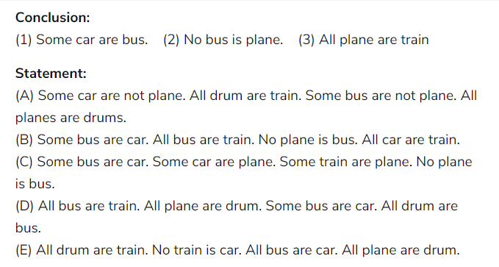
Problem 14
Ans: Option e
A
B.
C
D
E

Slide 22
Problem 15
Conclusions:
Some aptitudes are reasoning. No reasoning is current affair.
Some current affairs are banking.
Statements:
No current affair is aptitude. All reasoning is banking.
Some banking is aptitude.
All banking is aptitude. No aptitude is reasoning.
All reasoning is current affair.
Some banking is reasoning. No reasoning is current affair.
All aptitudes are banking.
All reasoning is aptitude. Some aptitudes are banking.
No banking is current affair.
No reasoning is banking. All current affairs are banking.
All reasoning is aptitude.
I
II
III
d. IV
V
Ans: Option b

Slide 23

Thank you Narayan

